Slide 1
CPCSSN Secure Research Environment (SRE)
THE ANALYST’S GUIDE

Slide 2
Have these at hand:
VPN password
Remote Desktop username and password
IP address of your Virtual Machine (VM)
Database username and password
IP address of the database server: 10.15.1.150
Name of your SQL Database
Name of your ODBC Data Source

Slide 3
Step 1: Login to the SRE
There are 2 components required:
OpenVPN Connection*
Microsoft Remote Desktop
*technical details are provided in the SRE User Guide

Slide 4
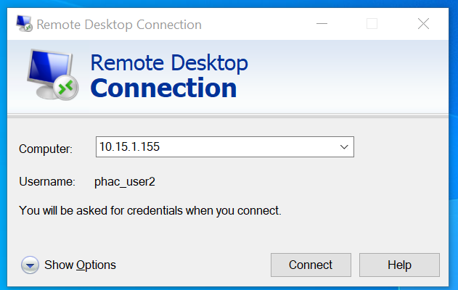
Remote Desktop Connection Dialog
Enter the Computer IP Address. This is unique to each SRE Project and is provided by the SRE Systems Administrator:
10.15.1.xxx
Enter your SRE username
If a different username is populated, select Show Options and then enter your SRE username provided by the SRE System Administrator
You will be prompted for your password when you login

Slide 5
Step 2: SQL Server Database Access
SQL Server Management Studio

Slide 6
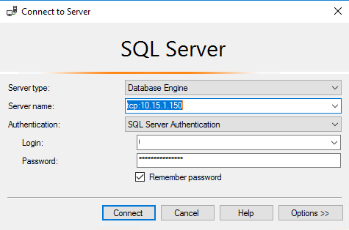
Step 3: SQL
Open up Microsoft SQL Server Management Studio
At the login page put in the server name tcp:10.15.1.150
Then put in the database login and password that was provided to you
Once you have successfully logged in you should now be able to see a list of all the CPCSSN tables under your database, listed on the left hand side under ‘Tables’.

Slide 7
Open Database Connectivity (ODBC)
The CPCSSN data is stored in SQL tables.
The best way to access the SQL tables in your statistics software (ex. SAS, R, SPSS, or Stata), while maintaining the integrity of the data, is to set up an ODBC connection.
The SRE System Administrator has set up an ODBC connection for you, and the name of your ODBC data source will have been provided to you.

Slide 8
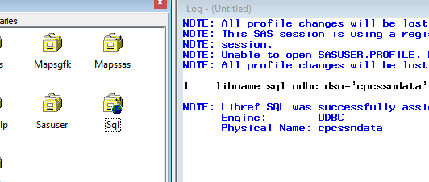
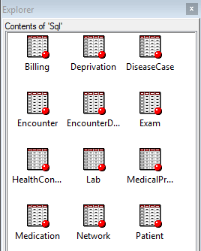
Step 5: SAS
Open up SAS
In a new program window create a Library that points SAS to the SQL database (this code is also described in the SRE Documentation)
LIBNAME CPCSSN DSN=’cpcssndata’ user=uuuuuu pw=ppppppp schema=dbo;
CPCSSN – in this example the Library is called “Sql”, but you can choose any name.
dsn = name of the ODBC data source
user = database username
pw = database password
Once you have created the new library it will be visible on the left hand side under Libraries (it will have a little ‘world’ icon on it).
Opening up the Library you should now be able to see all your CPCSSN tables (note this image may have some tables that are not in your database).
Note: the name of your SAS library is not case sensitive

Slide 9
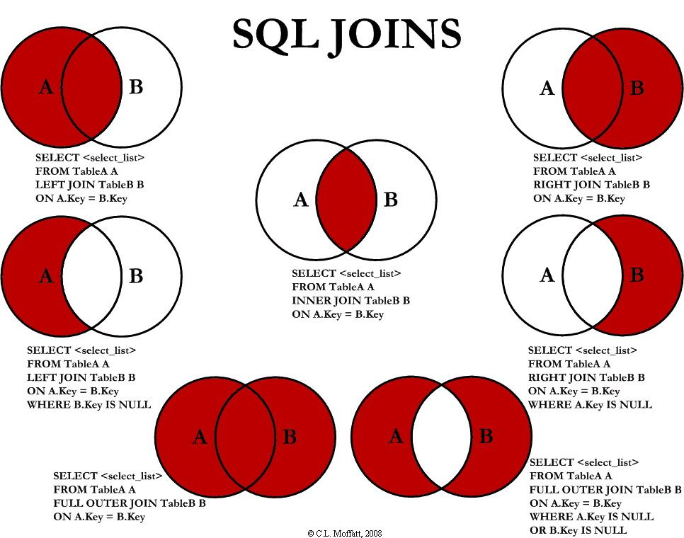
Step 6: Linking tables in SAS
There are many different ways you can link tables in SAS.
Here is a diagram outlining the types of joins you can make using proc sql.

Slide 10
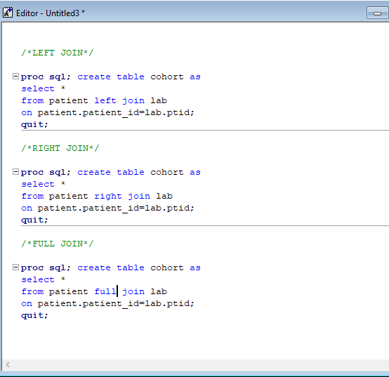
Step 6: Linking Tables in SAS
Some things to keep in mind
Your linking variable will most often be the patient ID
Most tables have many observations per patient
It is advisable to create a main table that has your sample of patients (one observation per patient), and to link your other tables (that may have >1 observation per patient) to this main table.

Slide 11
Other Statistics Programs
R
Sample R database connect script (access the SQL tables using the ODBC connection)
library(odbc) con <- dbConnect(odbc(), Driver = "SQLServer", Server = "10.15.1.150", Database = "your_database", UID = "your_user_name", PWD = rstudioapi::askForPassword(“your database password ") Port = 1433)
SPSS
Click on File -> Import Data -> Database -> New Query.
The Database Wizard will appear. Connect your ODBC Data Source that was created for you.
Select the tables that you wish to import.

Slide 12
Please contact:
Technical questions (e.g. using openVPN, remote desktop login, etc): dwhite02@mail.ubc.ca
Analyst questions (SQL, SAS, etc): rachaelm@cpcssn.org

